Slide 2
DF TICKETING SYSTEM Mobile Compatible https://dfticketing.org

Slide 3
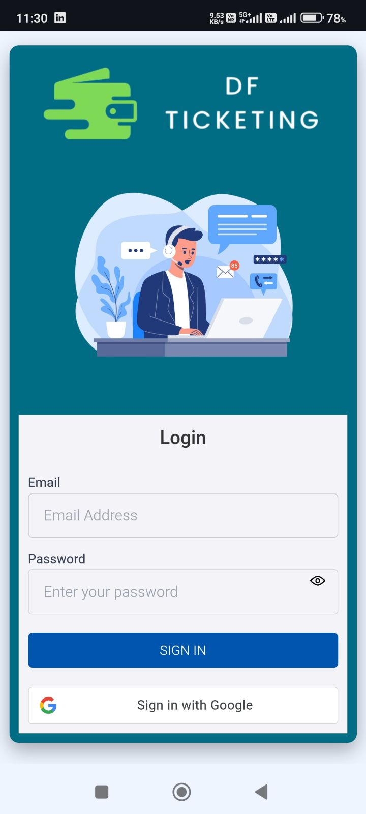
Login Page
You can log in using your DF email and the auto-generated password sent to your registered email address.
OR
You can log in using the Google option with your registered DF email address.

Slide 4
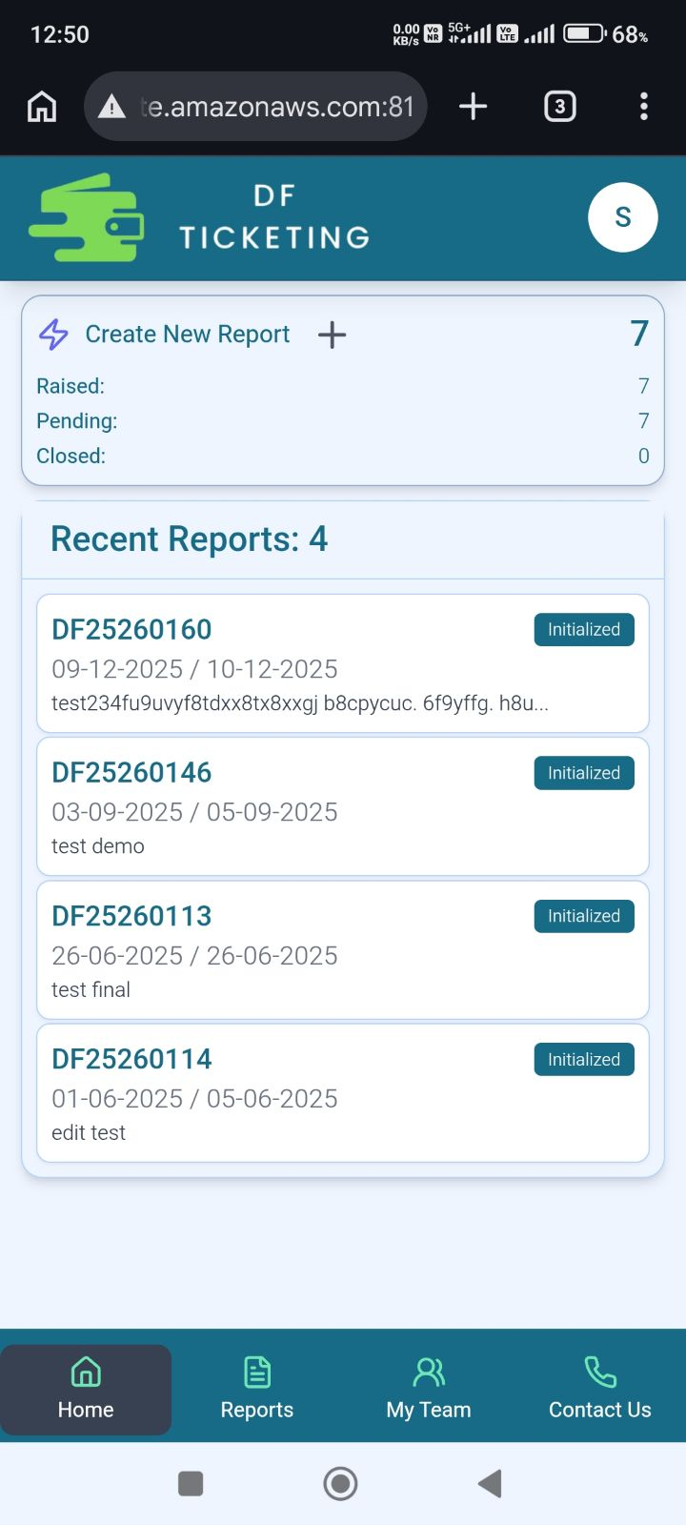
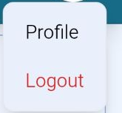
Home Page
This is the Profile section
Click the plus (+) button to create a new report.
In this section, you can view the Report Details, including the Report Number, Report Period, Process Status, and Report Description.
Home page
Reports page
Contact Us page
My Team page

Slide 5
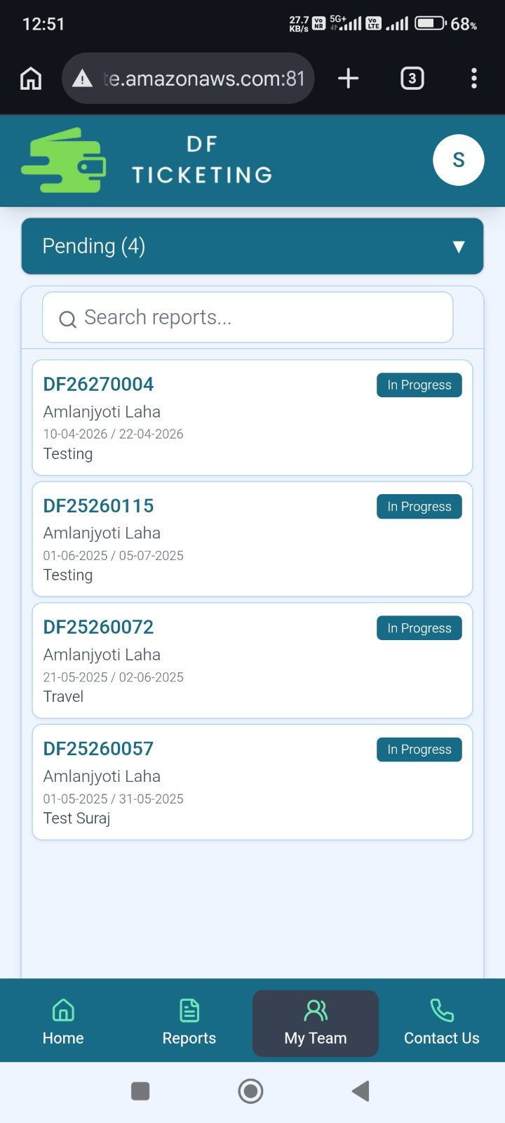
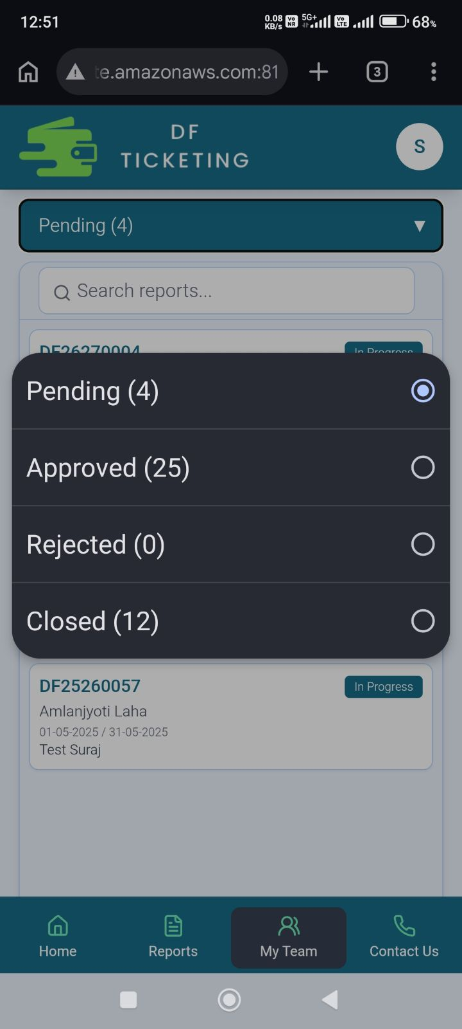
Manager Page (My Team)
Count of Reports status
List of reports raised by Manager’s Team
Managers can view the reports raised by their team under the 'My Team' section.

Slide 6
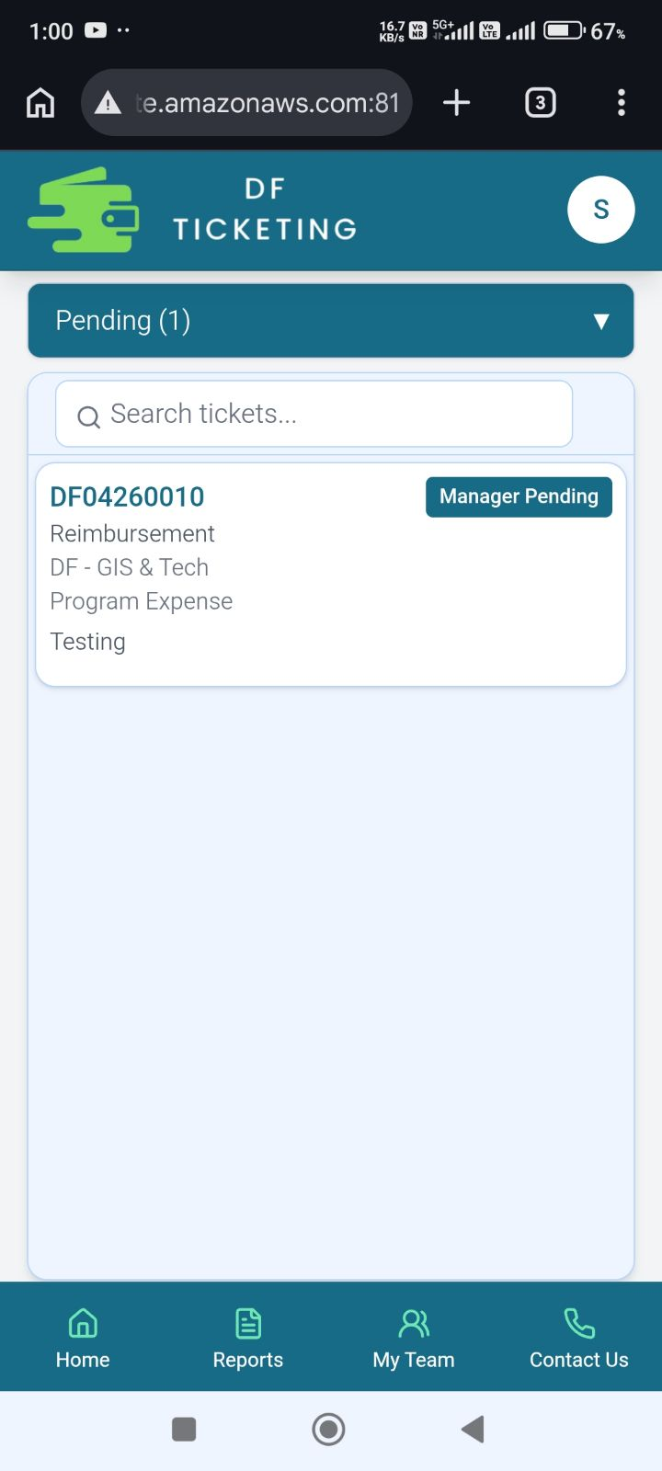
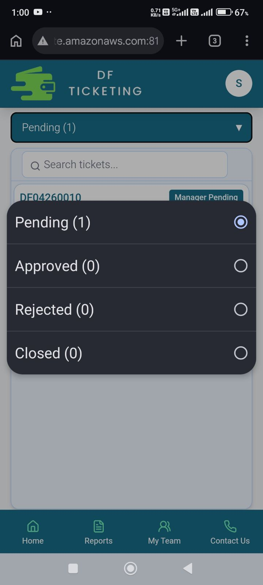
Inside Report (My Team)
Count of tickets status
List of tickets raised by a team member inside the report

Slide 7
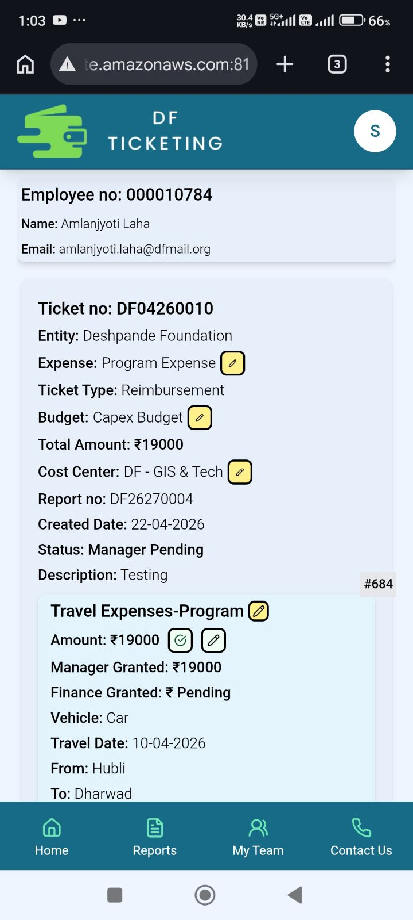
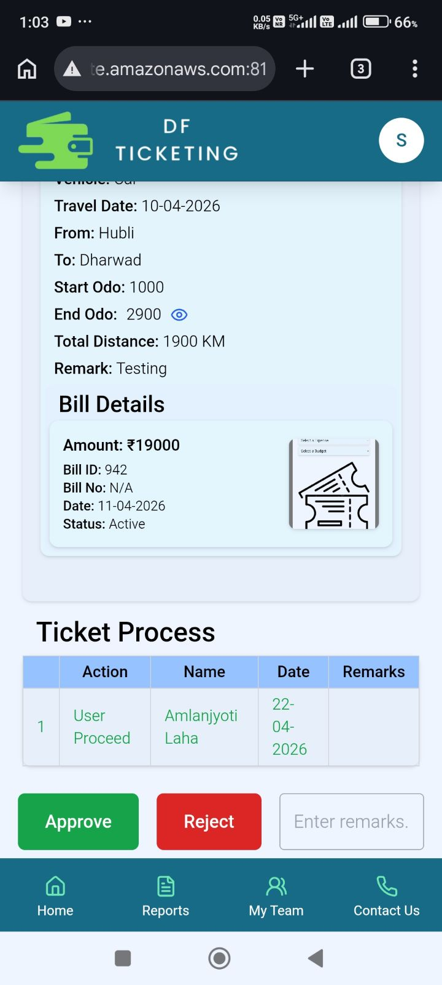
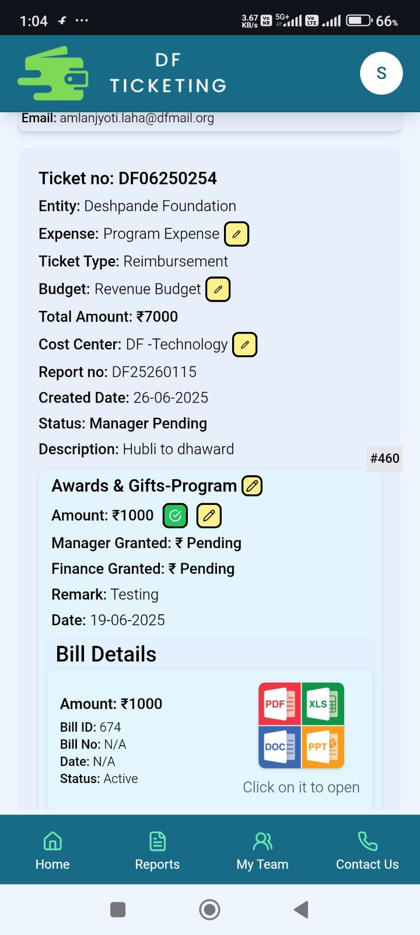
Inside Ticket (My Team)
Once all the Manager grants of all the section is ticked , then only the Approve button appears.
Once checked , a popup will come and the colour will fade . And the Manager grant amount will be filled automatically
Managers need to approve/modify the amount in every section then they will get the approve button for the ticket.

Slide 8
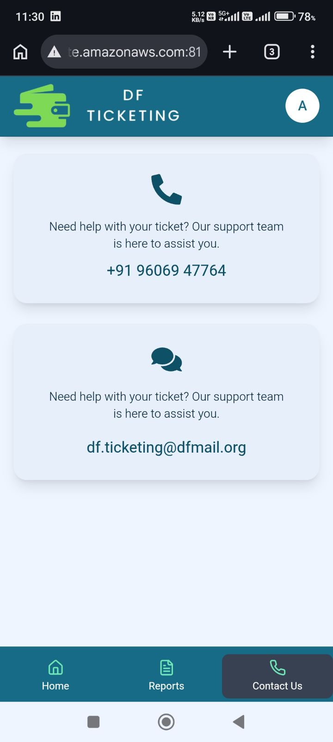
Contact Page

Slide 9
Thank You

